Slide 1
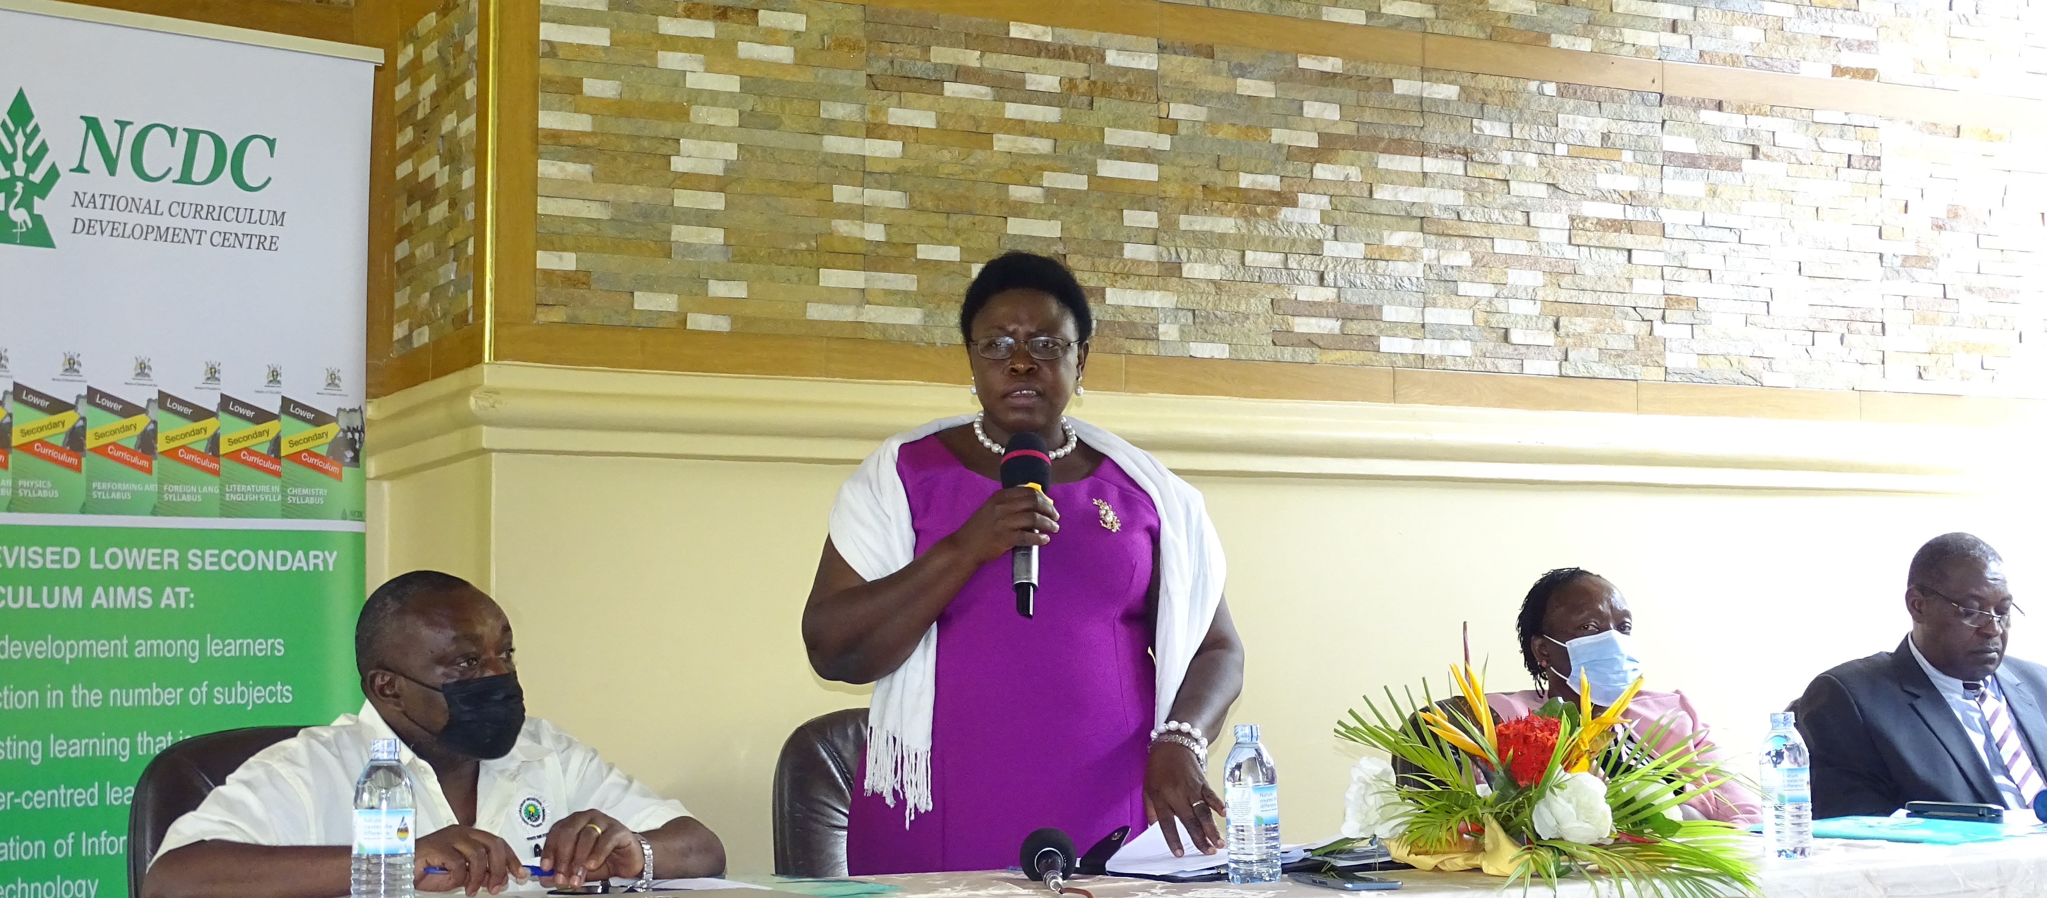
PROPOSED REVIEW OF THE ADVANCED LEVEL CURRICULUM
PRESENTED TO THE UNIVERSITY VICE CHANCELLORS
AND OTHER STAKE HOLDERS
BY
THE MANAGER SECONDARY ON 11TH JANUARY, 2023

Slide 2
STRUCTURE OF THE PRESENTATION
INTRODUCTION
NEEDS ASSESSMENT STUDY FOR A’ LEVEL
PURPOSE OF THE REVIEW
UNDERLYING PHILOSOPHY OF A’ LEVEL EDUCATION
PROPOSED A’ LEVEL LEARNER PROFILE
THE SUGGESTED CHANGES IN THE ‘A LEVEL CURRICULUM
PROPOSED SUBJECTS AT A- LEVEL
PROPOSED SCENARIOS OF SUBJECTS TO BE OFFERED BY A LEARNER AT ‘A LEVEL
IMPLICATIONS OF THE REVIEW OF THE ‘A LEVEL’ CURRICULUM
PRAYER
2.

Slide 3
1. INTRODUCTION
Global and national education systems around the world, are seeking innovative curriculum reforms.
Vision 2040 with human capital development as one of its key programmes.(NDP III, Sustainable Development Goal number 4, African Union Agenda 2063, ETC)
curriculum must be seen as a tool for a country’s economic and social development.
The main purpose of secondary education in Uganda, is to educate individuals within society, to prepare and qualify them for work in the economy, to integrate into society and teach them the values and morals of society.

Slide 4
2. NEEDS ASSESSMENT STUDY FOR A’ LEVEL
In 2021/22 NCDC conducted a needs assessment study to identify the gaps in the ‘A Level’ curriculum.The following gaps were established:
The A-level curriculum does not equip graduates with functional skills to adequately address the social and economic needs of the country.
The ‘A Level’ graduates cannot apply the acquired knowledge and skills when they join the labour market.
It is not aligned to the international curriculum trends (CBC, 21st, Century Skills, Learner Centred Pedagogies, assessment of achievements)
It is not aligned to the emerging issues(digital literacy, climate Change, Sustainable Development Goals, Globalisation, Global Epidemics)

Slide 5
2. NEEDS ASSESSMENT STUDY CONT..
It is not aligned to the existing ECD, Primary, Lower secondary and TVET curricula in terms of design.
The existing A-level curriculum was designed based on the Castle Education Commission of 1963.
The A-Level curriculum is content heavy and some of the content is obsolete and overlap.
The existing curriculum is exclusive. Its is funnel shaped.
The current S.6 leavers have limited employable skills, they lack skills to start and operate income generating enterprises.

Slide 6
3. PURPOSE OF THE A’ LEVEL CURR. REVIEW
The purpose of the review is to eliminate the gaps and weaknesses in the A’ Level curriculum with the aim of optimising the learning experience of the learner, for the achievement of the educational goals of Uganda.
OBJECTIVES
To align the A’ level curriculum with that of the NLSC.
To integrate the desired skills, knowledge, values and attitudes expected of an ‘A level graduate.
To remove repetitions and obsolete knowledge in the curriculum and take on new knowledge.
To review the teaching methodologies.
To introduce school-based assessment to promote learning.
To vocationalised secondary education.

Slide 7
4. UNDERLYING PHILOSOPHY OF A’ LEVEL EDUCATION
To produce a self-reliant, patriotic and morally upright citizen with leadership skills for national development

Slide 8
5. PROPOSED A’ LEVEL LEARNER PROFILE
patriotic, disciplined and rooted in Ugandan diverse culture
conscious of the need to preserve and protect the environment for the sustainable and productive use of present and future generations
a critical thinker who can critically analyse situations and creatively develop new ideas /solutions for existing challenges
inventive and enterprising
an inquirer who analyses data and information to make informed judgment based on logic and facts and carries out investigations to make feasible recommendations

Slide 9
. PROPOSED A’ LEVEL LEARNER PROFILE
knowledgeable individual who applies acquired knowledge; to explain different phenomena, in new situations and uses it for self and community development
an effective communicator who expresses him/herself creatively and confidently orally and in writing
exhibit leadership skills and highly effective in supporting others to attain common goals and achieve sustainable results for the benefit of everyone and the country at large.
a team player who works collaboratively with others in harmony, sets realistic goals and works towards achieving them.

Slide 10
PROPOSED A’ LEVEL LEARNER PROFILE CONT…
open-minded individual who respects other peoples’ ideas and opinions
applies various technologies for personal and community development.
open-minded individual who respects other peoples’ ideas and opinions
applies various technologies for personal and community development.
able to engage in independent life-long learning

Slide 11
6. THE SUGGESTED CHANGES TO THE
‘A LEVEL CURRICULUM
The need to change the curriculum design from objective based to a CBC
Adoption of learner-centred approaches to teaching.
Reduction and harmonisation of content across subjects to get rid of repetitions and obsolete knowledge while integrating emerging issues.
Integrating ICT in all subjects as a tool for learning.
Emphasis practical, generic Skills, values and attitudes across all subjects.
Introduction of School based assessment to constitute 20% of the end of cycle grade.

Slide 12
6. THE SUGGESTED CHANGES TO THE
‘A LEVEL CURRICULUM CONT..
Vocationalisation and introduction of a Vocational Occupation.
Introduction of contemporary studies to replace GP.(Generic Skills, ICT skills, Research skills, Financial literacy, Basic Nutrition, Climate Change, Functional Statistics, peace building)
Dropping the policy of considering results in one sitting.(a learner to repeat only a failed subject)
The tenure for A’ level to be a minimum of 2 years and maximum of 5 years to enhance inclusivity.

Slide 13
7. PROPOSED SUBJECTS AT A’ LEVEL
HUMANITIES
  CRE
  IRE
  Geography
  History & Political Education
  Literature
SCIENCE
  Mathematics
  Physics
  Chemistry
  Biology

Slide 14
PROPOSED SUBJECTS AT A’ LEVEL CONT..
VOCATIONAL
ICT
Art and Design
Technology and Design
Nutrition and Food Technology
Textile and Clothing Technology
Performing Arts
Economics
Entrepreneurship
Accounting
Agriculture
Physical Education
LANGUAGES
Local languages
Foreign Languages
Kiswahili
Ugandan Sign Languages

Slide 15
8. PROPOSED COMBINATION FRAMEWORK
DESIRED CAREER PATH
ECONOMIST
VOCATIONAL/ TECHNICAL CAREER PATH
2. WORLD OF WORK
2 ESSENTIAL PRINCIPALS
1. ECONOMICS
3. CONTEMPORARY STUDIES
VOCATIONAL OCCUPATION
2. MATHEMATICS

Slide 16
COMPOSITION OF THE CONTEMPORARY STUDIES SUBJECT
Personal development,
financial literacy
ethics and integrity
leadership
ICT
Basic nutrition
global citizenship
patriotism
Inclusion
Climate Change
Functional statistics
Heath education
sustainable development
emotional Intelligence
Peace building

Slide 17
9. IMPLICATIONS OF THE ‘A LEVEL’ CURRICULUM REVIEW
There are two concurrently ongoing interventions in the education system; the review of the A-level curriculum and the Education Review Commission. What should feed into the other?
There is need to harmonise the pre-service teacher training programmes with curriculum.
There is need to make ICT accessible to all ‘A Level’ learners
Make appropriate choices of subject combinations to deliver the desired learner exit profile.
The respective MoES departments should develop key activities to support the review and implementation

Slide 18
9. IMPLICATIONS OF THE ‘A LEVEL’ CURRICULUM REVIEW
Considering the amount of work to be accomplished vis a vis the available time, there is need to hire consultancy to guide the review process
The pioneers of the competency-based curriculum will be in Senior 3 by 2023. This allows NCDC only 2 years to deliver the revised curriculum

Slide 19
PRAYER
NCDC requests the Vice Chancellors, Academic Registrars and Key Stake Holders to receive, discuss and make recommendations to the Proposed A’ level Curriculum Review.

Slide 20
Thank you for your kind attention
For God and my Country.

